Slide 1
Eating Smart • Being Active
Curriculum Revision Overview
Notes:
Materials needed:
Lesson plans for lessons 1 and 2 for all participants
Cutting mats and water bottles
In this discussion, I’ll provide you with information on recent changes to the Eating Smart Being Active curriculum. Since the last curriculum was released, the authors have made many changes. This information will give you an overview of what has stayed the same and what has changed.

Slide 2
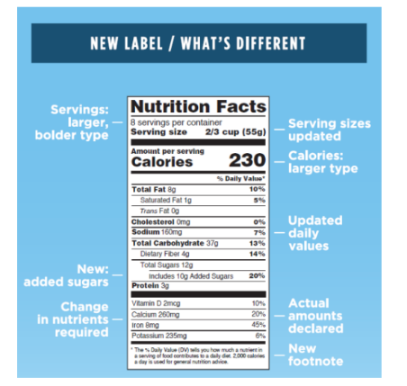


Rationale for Changes
Educator feedback
  Change physical activity segments
Involving participants in Let’s Cook! activities
New research and recommendations
  2015-2020 Dietary Guidelines for Americans, the latest research on physical activity, and new Nutrition Facts Label
Notes:
The curriculum authors surveyed educators and made changes to each lesson based on that feedback. One of these changes includes different physical activity segments. They are so thankful to the educators who gave their time and ideas to this process.
The authors also noted the need to involve more participants when preparing food in class. We’ll talk more about this in a minute.
Finally, the curriculum has been updated with the latest research so you can pass on the best information to your participants. These updates include:
2015 Dietary Guidelines – these guidelines are national nutrition recommendations that advise us how to eat healthfully.
Latest research on physical activity – because the Physical Activity Guidelines were last updated in 2008, this curriculum update also includes information from the latest research on physical activity.
Updated Nutrition Facts Label – the FDA has required all large food manufacturers to use this new label by the summer of 2018.

Slide 3
What Stayed the Same?
Content based on the Dietary Guidelines for Americans, Physical Activity Guidelines for Americans, and latest research
Lesson plans focused on the learner
Series of lessons
  9 lessons – new Welcome to Eating Smart • Being Active lesson
Many similar lesson topics
Printed materials and lesson enhancements
  Updated visuals, worksheets, handouts, and lesson enhancements
Notes:
Nutrition and physical activity content in the lessons are still based on national recommendations and the latest research.
Lesson plans continue to be focused on the learner, with lots of opportunities for hands-on activities.
The curriculum is still designed to be taught in a series of lessons but now has 9 lessons instead of 8. A new Welcome lesson has been added. We’ll talk about this in more detail in a minute.
The curriculum also still contains many of the same lesson topics.
There are still printed materials (visuals, worksheets, and handouts) to go with every lesson, but they have been updated to reflect updated lesson content and given a more modern look.
There are also still enhancements for each lesson, but these have been improved based on educator feedback.

Slide 4
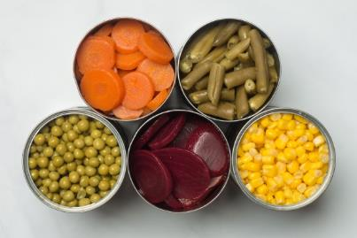
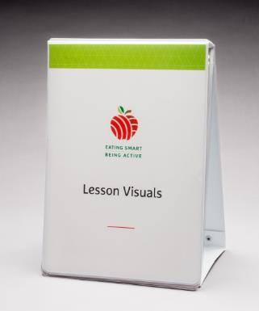
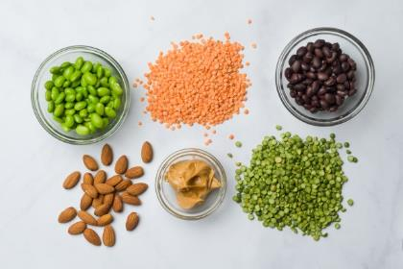
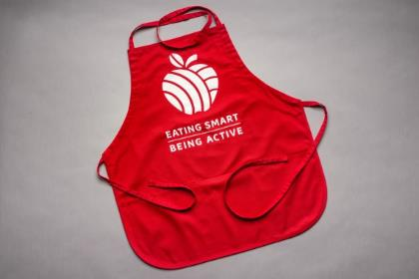
A New Look
New photos
Updated format
New logo
Notes:
One of the first things you will notice about the new curriculum is that it has a fresh and modern look. There are new photos, an updated format, and a new logo.
We also have new aprons (shown here).

Slide 5
New Lesson 1
Lesson 1: Welcome to Eating Smart • Being Active
Lesson 2: Get Moving!
Focus on building rapport
Provide info about lessons
Prepare a popular recipe
Practice knife safety skills
Introduce physical activity for future lessons
Paperwork at the end of lesson – demographic info and checklist
In-depth information about physical activity
Explanation and instructions for the physical activity segments
Prepare a popular recipe
Paperwork – 24-hour dietary recall
Notes:
Another thing you will notice right away is that there’s a new lesson. Some educators let the authors know it was hard to build strong relationships with new participants and keep them excited about the lessons when the original lesson 1 was full of paperwork.
The new lesson 1 will help you introduce the lessons and build a stronger bond with participants. The paperwork is now split between lessons 1 and 2, so there is less to complete at the first lesson.
The new lesson 1 will:
Focus on building rapport with participants
Give participants info about the program and an overview of the lessons
Include a full food preparation with a popular recipe (Fried Rice with Chicken or Stir-Fried Vegetables with Beef, Chicken or Tofu)
Teach and practice knife safety skills
Introduce physical activity segments in future lessons. Lesson 1 does not have physical activity. This is because you haven’t had a chance to tell participants how to dress appropriately for it. This lesson includes discussion of what to expect and suggestions for what to wear for future lessons. There is a stretch break in lesson 1 but no other activity in this lesson.
Paperwork at the end of lesson (demographic information and behavior checklist)
Updated lesson 2 (Get Moving) will include:
In-depth information about physical activity
Explanation and instructions for the physical activity segments
A full food preparation with one of our popular recipes (Enchilada Casserole or Skillet Lasagna)
Finish paperwork (24 hour recall)

Slide 6
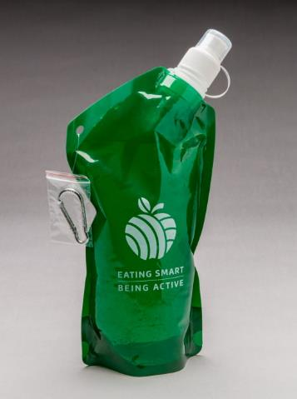
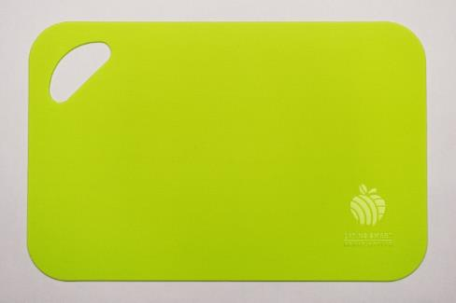
New Lesson 1 and 2 Enhancements
Lesson 1 enhancement
Lesson 2 enhancement
Notes:
The enhancement for lesson 1 is a cutting mat – appropriate because we learn and practice knife safety skills in this lesson.
The enhancement for lesson 2 is a collapsible water bottle – cleaning instructions are printed right on the water bottle. This bottle collapses flat for easy carrying when it is not being used.

Slide 7
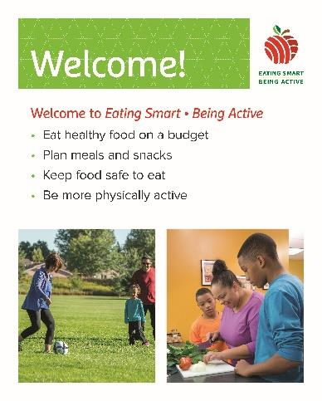
New Lesson Order
Welcome to Eating Smart • Being Active
Get Moving!
Plan, Shop, $ave
Fruits & Veggies: Half Your Plate
Make Half Your Grains Whole
Go Lean with Protein
Build Strong Bones
Make a Change
Celebrate! Eat Smart & Be Active
Notes:
The order of Go Lean with Protein and Build Strong Bones has been swapped compared to the original version because:
The order of the food groups is the same as MyPlate in the Dietary Guidelines.
Go Lean with Protein is where we introduce food safety. This is very important for both dairy and meat products. Putting Go Lean with Protein first introduces these important concepts before talking about dairy foods.

Slide 8
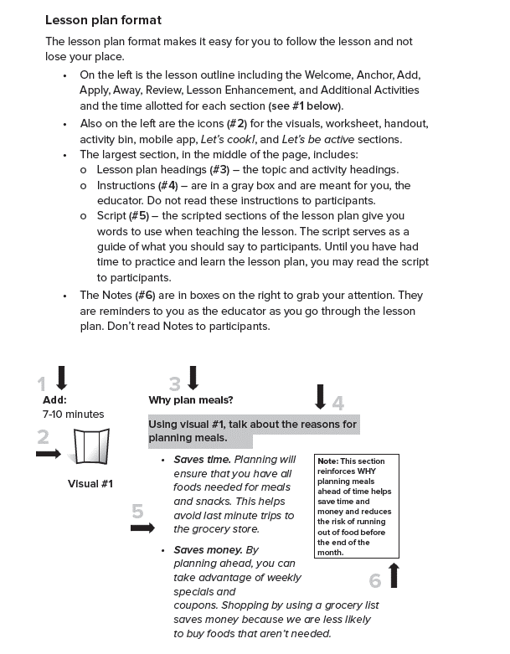
New Lesson Plan Format
Notes:
The lesson plans are formatted differently than the previous versions of the curriculum:
Overall outline (anchor, add, apply, away) is on the left hand side of the page.
Script and instructions are clearly separated – instructions are in gray boxes, and the script is italicized.
Notes for the educator are on the right hand side of the page.
Lesson plans also contain a lot more detail than the previous version of the curriculum. This is to make the lesson easier to follow and teach.

Slide 9
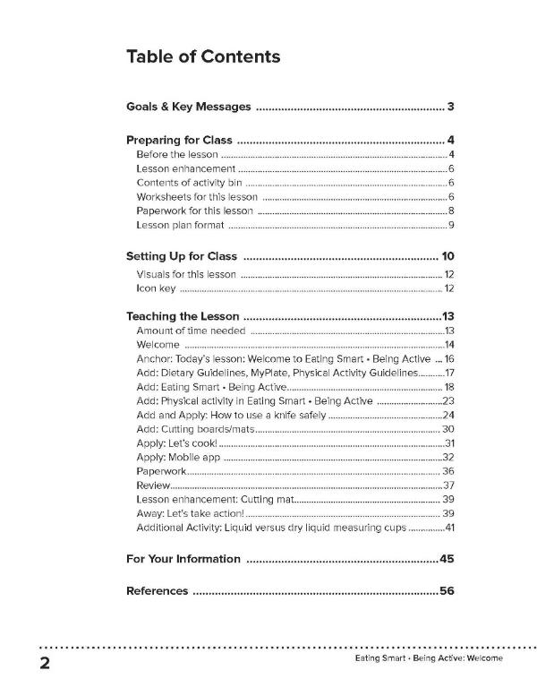
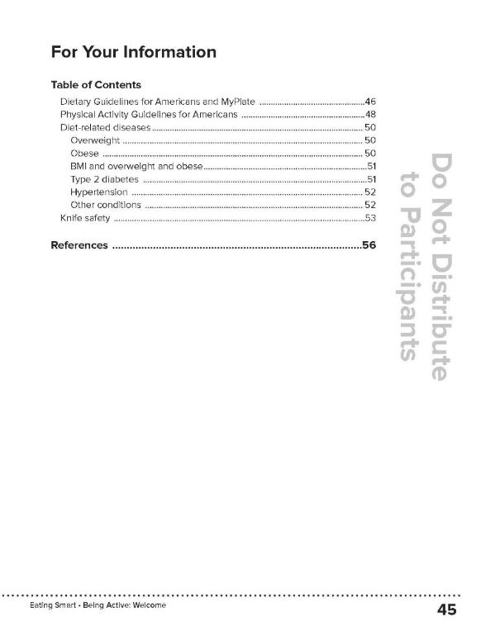
New Table of Contents
Notes:
We have added a Table of Contents to the beginning of the lesson and a Table of Contents for the FYI. These are intended to help you find specific sections quickly.

Slide 10
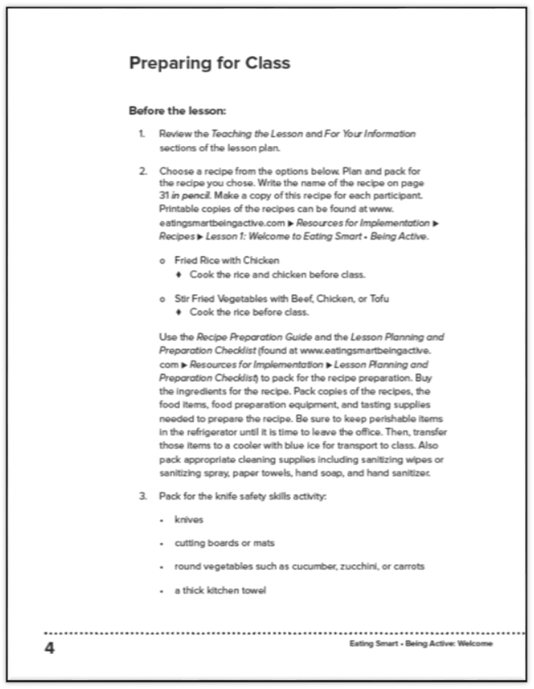
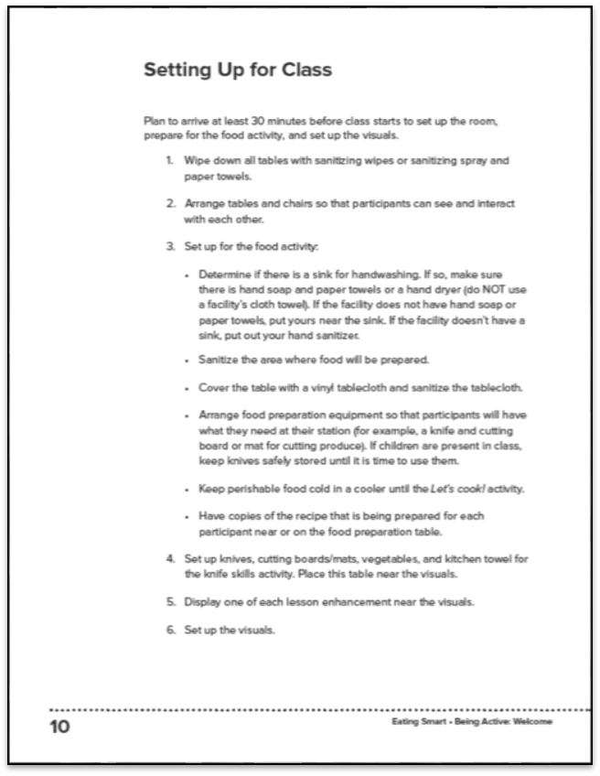
Updated Preparing for Class and
New Setting Up for Class Sections
Notes:
The Before the Lesson section has been updated and expanded to the new Preparing for Class section. This section contains more detail to help you pack and prepare for class.
A new section called Setting Up for Class has been added. This section is meant to be a checklist for you when you get to the class location.

Slide 11
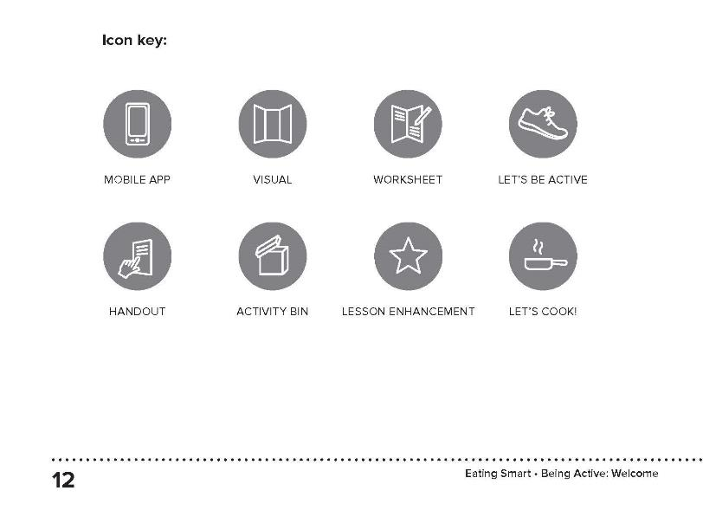
Updated Icon Key
Notes:
The icons have been redesigned. The icons indicate when to interact with a specific material. For example, the Worksheet icon is displayed every time you use the worksheet in class not just when you hand it out.
They also indicate when a significant activity is happening like the Let’s cook! and Let’s be active! sections.
We have also added a new icon for the mobile app sections. We’ll talk more about the Eating Smart • Being Active mobile app in a minute.

Slide 12
New Reflection Section
Notes:
Lessons 3 through 9 begin with a reflection on reaching goals set in the previous lesson. Participants are asked to look at their worksheet from the previous lesson and talk with a partner about whether or not they reached their goal. If they didn’t, they are prompted to reflect on why they think that is.
Activity bins will contain several laminated copies of the worksheet from the previous lesson in case participants did not bring theirs to class.

Slide 13
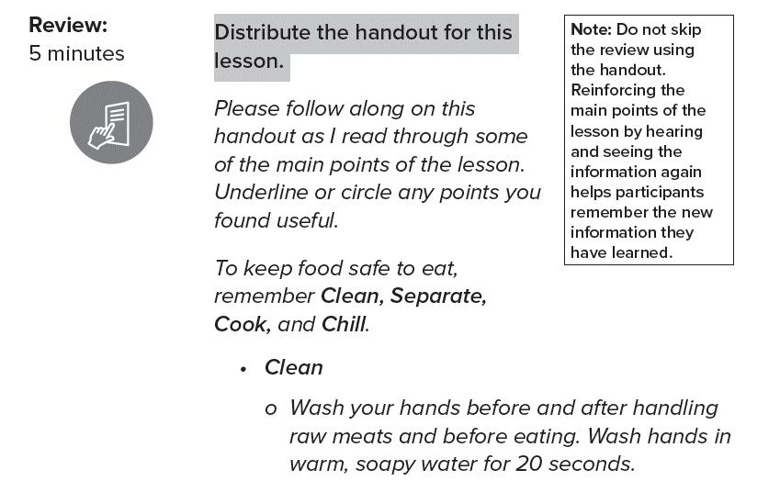
New Review Section
Notes:
Lessons 1 through 8 wrap up with a walk-through of the key points from the lesson. Participants are asked to follow along on their handout as the educator reviews the main points.
After this review, participants still write down their goals for the week on their worksheets before leaving class.

Slide 14
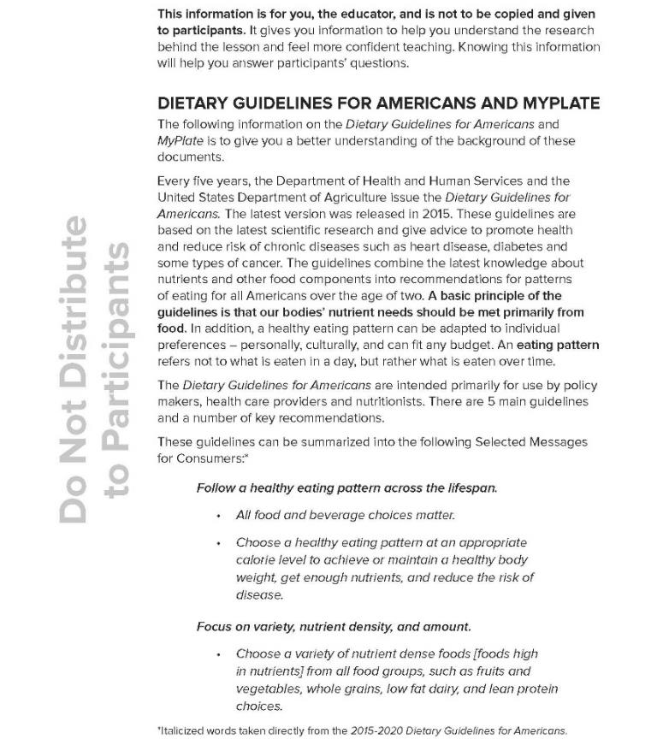
Updated FYI Section
Notes:
The FYI format is the same, but information has been added to all lesson FYIs about current hot topics and common questions. Examples include gluten, GMOs, food preservation, and raw milk.

Slide 15

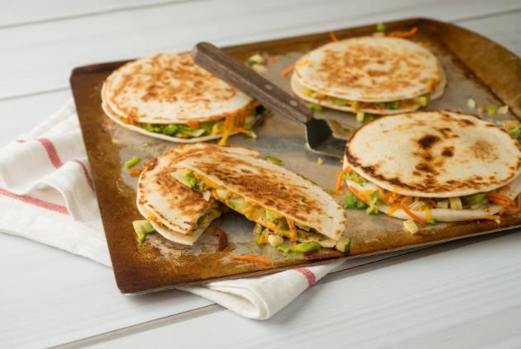
Food Activity Updates
All food activities are food preparations
New recipes added to the curriculum and cookbook
Updated Let’s Cook! cookbook
New cookbook-only recipes
Notes:
Food activity revisions:
As with the previous version of the curriculum, there are food activities in every lesson.
Now, there is no longer a tasting option for the food activities. All are food preparations to encourage participant involvement and learning cooking skills.
New recipes – using field feedback from educators from multiple states, the authors removed and added some recipes. They also modified, retested, and changed some of the recipes.
The cookbook (the enhancement for lesson 9) has also been revised with new recipes and beautiful new photos. It has more recipes than the past cookbook and is also larger in size (closer to 8 ½ x 11”)
There are also new recipes in the cookbook that are cookbook only recipes. These include pizza dough and marinara sauce, a new granola recipe, and other recipes requiring an oven. You will not be preparing these recipes in classes, but they are good recipes for participants to have at home.

Slide 16
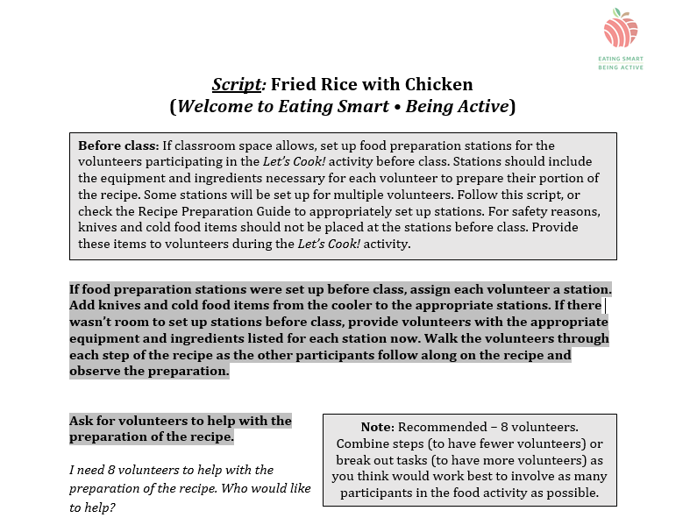
New Recipe Script and Planning and Preparation Checklist
Notes:
There are now scripts for teaching each of the recipes, a recipe preparation guide, and a planning and preparation checklist. This will help you remember everything you need for a food activity before leaving your office!

Slide 17
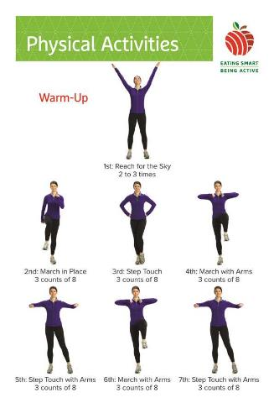
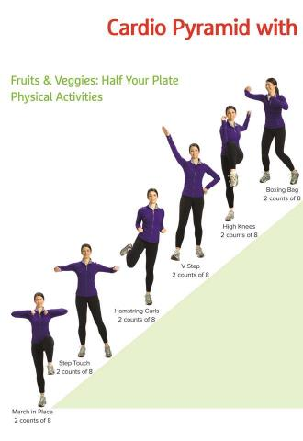
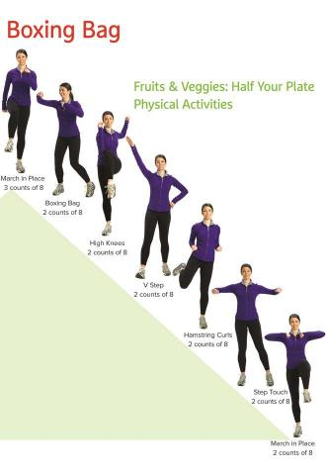
Physical Activity Updates
COMPLETELY redone physical activity segments
  New warm-up and cool down
  New aerobic activities
  New muscle-strengthening activities
  New physical activity visuals
Notes:
The biggest change to the revised curriculum is the new physical activity segments. They have been completely redone!
There is a new warm up and a new cool down.
There are 2 different options for aerobic activities.
There are new strengthening activities.
In addition to the regular content visuals, each lesson also has 3 physical activity visuals to use during the Let’s be active segment.

Slide 18
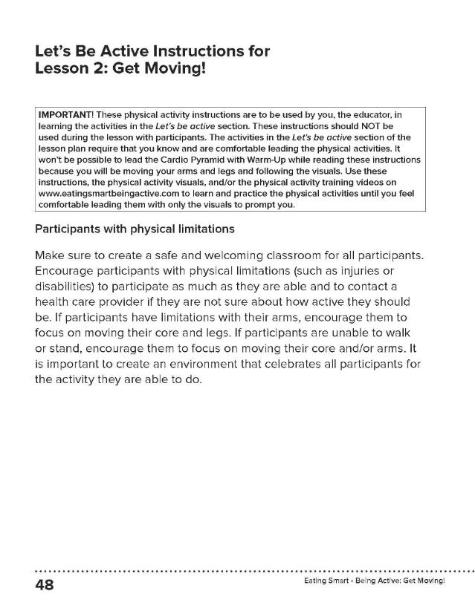
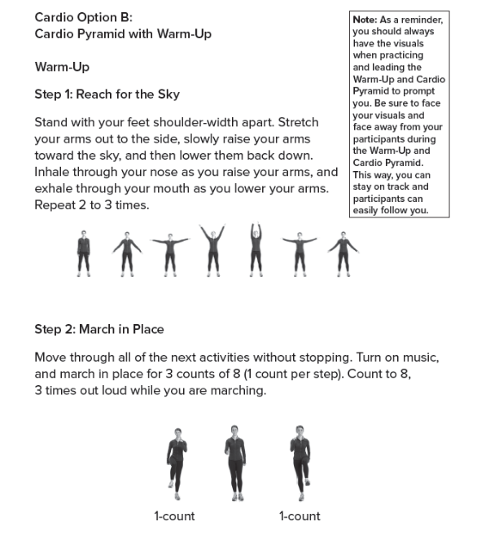
Let’s Be Active Instructions
Notes:
The detailed instructions for the physical activity segments are after the lesson (before the FYI. Educators need to memorize and practice leading the aerobic physical activity segments before doing them in class.
The instructions for the muscle-strengthening activities are in both places. Please use the script associated with the exercise to lead the activity in class. This will help you make sure people perform the activities correctly, reducing the risk of injury.

Slide 19
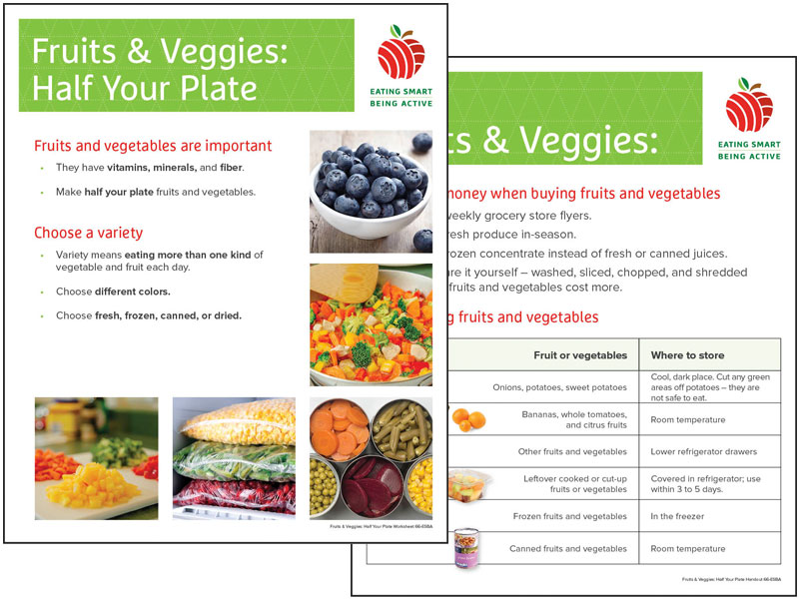
Updated Worksheets and Handouts
Notes:
As mentioned, there are still worksheets and handouts for each lesson. They have been revised and include new beautiful full color photos.

Slide 20
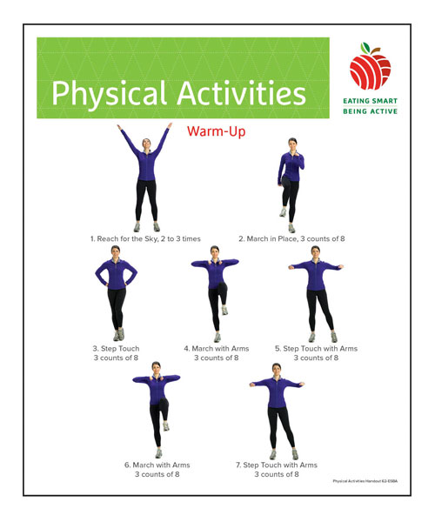

New Handouts
Notes:
There are also new handouts for the Physical Activities and Shopping at Farmers’ Markets.

Slide 21
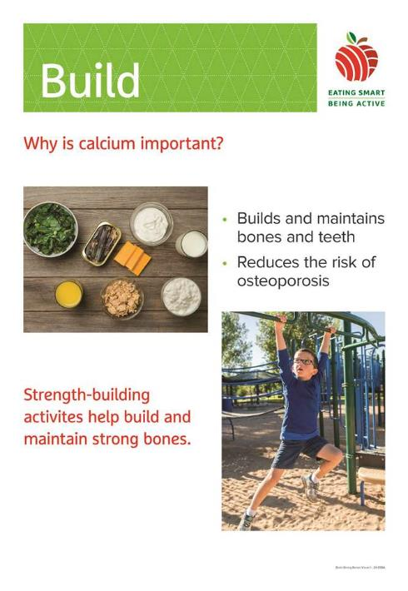
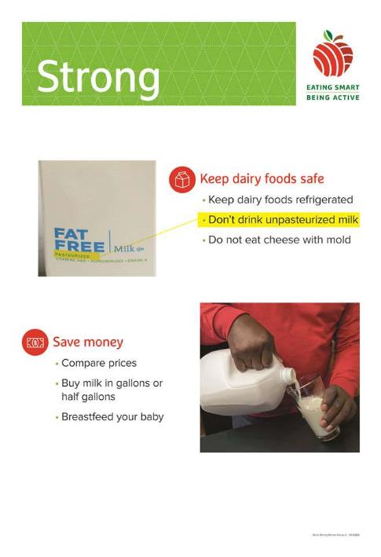
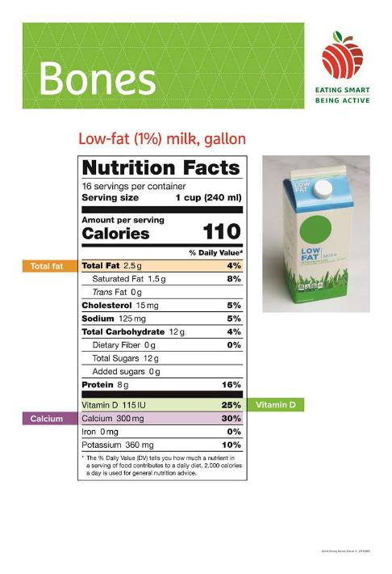
Updated Visuals
Notes:
As with the previous version of the curriculum, each lesson has 3 content visuals that you will use while you teach most of the lesson.
As was mentioned with the physical activity updates, you’ll use the physical activity visuals to lead that part of the class.

Slide 22
New: Tailor Lessons for Your Audience
New photos with people of various ethnicities, body sizes, and ages
Brief paperwork sections
Ability to skip parenting tips sections if no one in the class has children
Additional activities that can be used instead of the paperwork segments and/or parenting tips
Notes:
One of the things that we thought was important to include in this revision was the ability for you to tailor your lessons for your target audience. These changes include new photos – we included various ethnicities, body sizes, and ages in the photos.
The paperwork section is brief within the lesson plans and guides you to do paperwork appropriate for their program.
We recognize that some programs use our curriculum with groups of people that don’t have children. So each section that involves parenting tips guides the educator to skip these sections if they have classes of people that don’t have children living in the home.
Finally, there are additional activities which can be used instead of the paperwork segments and/or parenting tips if you have time.

Slide 23
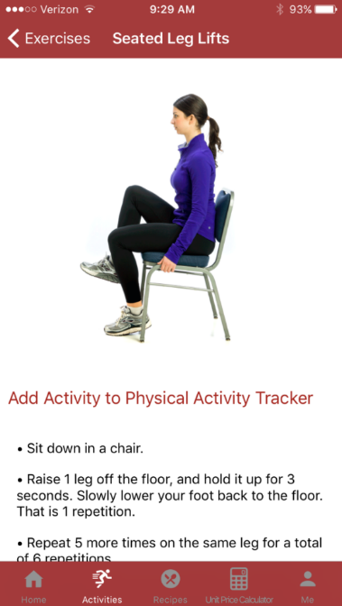
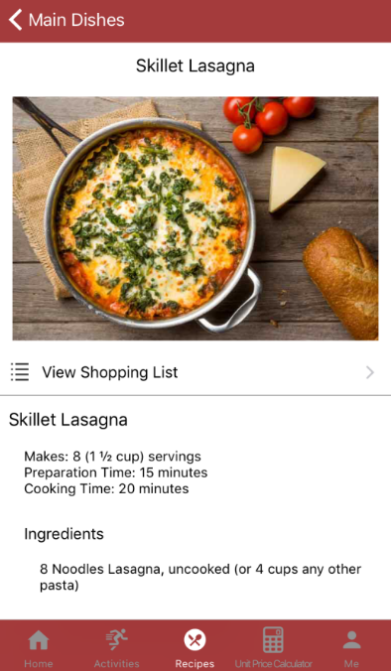
New Mobile Phone App
All recipes
All physical activities
Physical activity tracker
Notes:
We have been working with a tech company to develop an app that will go along with ESBA. The app is free and includes:
All ESBA recipes
All the new physical activities to make it easier for participants to practice activities.
A physical activity tracker that includes a step tracker, if the phone has that capability (the app can count the number of steps the participants takes in a day).
The app is introduced in Lesson 1 and used in all other lessons. The script and instructions are written into the lesson plans to help the educator walk participants through the different features of the app.
Please download and begin using the app (if you haven’t already), as you will need to be very familiar with how the app works by the time of your 1st class using the revised lesson plans.

Slide 24
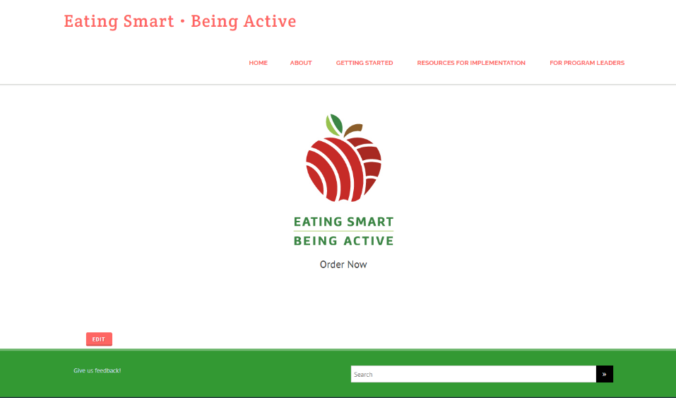
Updated Website
Notes:
There is also a brand new, redesigned website. The website has many materials which will be helpful for you to prepare for class. It has:
Videos of how to do and teach all the physical activities
Music suggestions for physical activity
MyPlate posters to print and use in class
Recipes
Food models and pictures you can print
A graduation certificate template
Posters to help you create a welcoming environment
And more!

Slide 25

Notes:
What questions do you have?

