Slide 1
The Revised Eating Smart • Being Active Curriculum
The Physical Activity Segments
Notes:
To accompany this PPT on the website:
Thoroughly read through the slides and notes. Make adjustments based on your program needs.
Determine timeline for educators to learn and practice the physical activities using the training videos after seeing this PPT.
Provide opportunities for educators to teach the physical activities to colleagues and supervisors. It is very important that they feel comfortable leading the physical activities before ever teaching them in class.
Eating Smart • Being Active authors have completely overhauled the physical activity segments in all the lessons. Learn more about the changes and the Physical Activities Guidelines that inspired the new material.

Slide 2
Physical Activity Segments in Eating Smart • Being Active
Physical activity segments rewritten based on latest research
2008 Physical Activities Guidelines for Americans
2015-2020 Dietary Guidelines for Americans
Notes:
In 2005, physical activity was added to the Dietary Guidelines. At this time, Eating Smart • Being Active started to incorporate physical activity into the lessons.
Since then, the 2008 Physical Activity Guidelines for Americans were developed, and the 2015 -2020 Dietary Guidelines were released. Physical activity recommendations have also changed based on the latest scientific research. Eating Smart • Being Active authors updated the physical activity segments in lessons to reflect these changes.

Slide 3
What are the Physical Activity Guidelines?
Science-based guidelines to help improve health through physical activity
Focus on preventive health
Physical Activity Guidelines recommend:
How much physical activity
What types of physical activity
Notes:
Most Americans do not get enough physical activity. Limited physical activity plays a major role in risk of chronic disease. Chronic disease not only negatively impacts quality of life but is a financial burden both on the individual and society.
The Physical Activity Guidelines provide guidance for Americans to help reach physical activity recommendations and experience the health benefits associated with physical activity.
The Physical Activity Guidelines give recommendations of how much and how often Americans should be doing physical activity and what types of physical activity people should be doing.

Slide 4
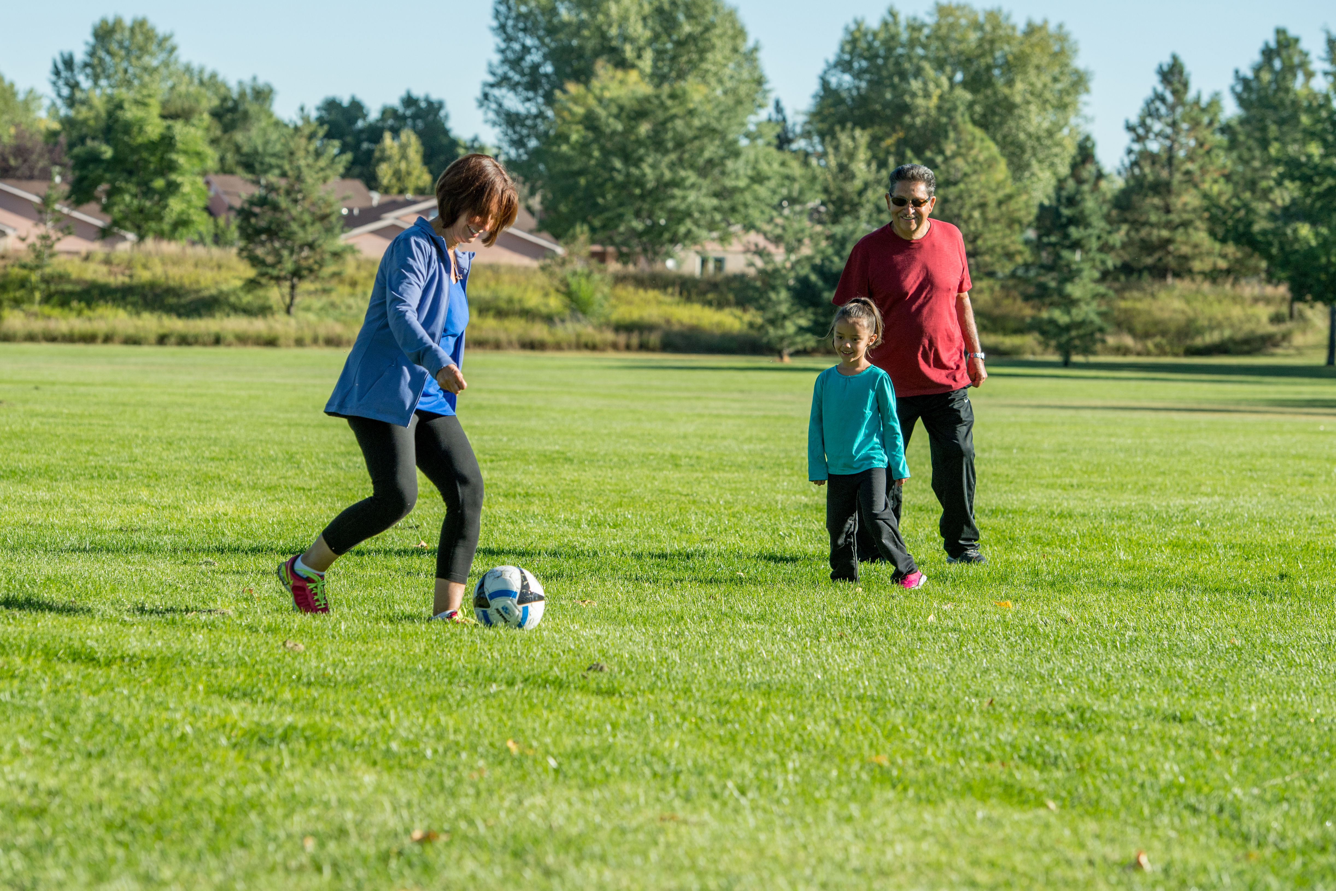
Physical Activity vs Exercise
Physical Activity: Bodily movement that enhances health
Exercise: Physical activity that is planned, structured, repetitive, and performed with the goal of improving fitness
Notes:
All exercise is physical activity, but not all physical activity is exercise.
Physical activity can look like a family taking a leisurely walk, cleaning the house, or doing yard work (this is physical activity but not exercise).
Exercise may look like friends walking with weights at a brisk pace 3x/week for weight loss (this is both exercise and physical activity).

Slide 5
Physical Activity Benefits
Increases life expectancy
Lowers risk of chronic disease
Improves heart health
Lowers risk of sudden heart attacks
Improves mood, brain function, and sleep
Notes:
Life expectancy – Physical activity has a large effect on preventing premature death from chronic diseases such as type 2 diabetes, metabolic syndrome, and colon and breast cancers.
All ages, races, ethnicities, and body shapes/sizes who are physically active have lower premature death rates than those people who are not physically active.
Heart health – this includes the heart, lungs, and blood vessels. Poor heart health is associated with death from stroke and heart disease. Some risk factors for heart disease include high cholesterol, high blood pressure, type 2 diabetes, smoking, and low fitness levels. Physical activity significantly improves heart health by decreasing risk factors that contribute to heart disease.
Improves mood, brain function, sleep – physical activity lowers the risk of depression and decline of brain function. It may also improve sleep quality.

Slide 6
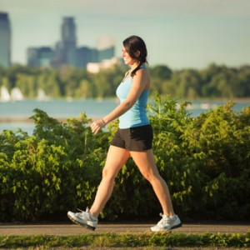
Types of Physical Activity
Aerobic
Stretching and balance
Strengthening
Notes:
Aerobic, muscle-strengthening, bone-strengthening, and stretching and balance activities are all beneficial.
Aerobic activities may also be called endurance training or cardio activities. These physical activities cause an increase in heart rate and breathing rate. Some examples are brisk walking, biking, jogging, jumping rope, dancing, and playing sports.
Strengthening:
Muscle-strengthening activities may also be called resistance training or lifting weights. They are physical activities that build and tone muscle. Some examples are weight lifting, resistance training, and body weight exercises such as push-ups and squats.
Bone-strengthening activities may be called weight-bearing activities and help increase bone strength. These can be aerobic or muscle-strengthening activities. Bone-strengthening activities put extra pressure on the bone by lifting extra weight or creating an impact when the feet hit the ground harder than normal. Some examples of bone-strengthening activities are weight lifting, brisk walking, jogging, and jump roping.
Stretching and Balance increase range of motion in the joints, improve flexibility in the muscles and tendons, and prevent falls. Stretching and balance activities include yoga, tai chi, pilates, dance, and gentle stretching.

Slide 7
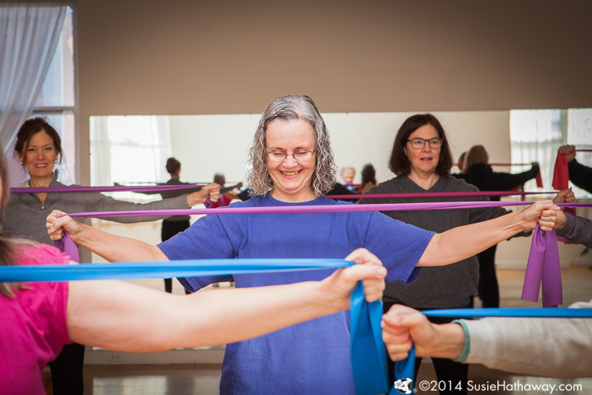
Physical Activity Recommendations
Total of 150 minutes of aerobic activity per week
Moderate-intensity
Muscle-strengthening activity at least 2 days per week
Notes:
As few as 60 minutes of physical activity per week has some health benefits. Research shows the most health benefits (greatest reduction in risk of chronic diseases) occur with a TOTAL ACCUMULATION of 150 min/week (2.5 hrs/week) of moderate-intensity aerobic activity.
Total accumulation means all physical activities add up over the course of a week. A person does not have to do 30 minutes of moderate-intensity physical activity 5 days a week to equal 150 minutes per week. One-hundred-fifty minutes of physical activity for a week could be multiple sessions of 10, 20, 30, or more minutes throughout the week; everything adds up. The goal is to reach 150 minutes per week with all the different types of aerobic activity a person does over those 7 days.
If 150 minutes per week is not a reasonable goal for a person starting out, that’s okay. Some physical activity is always better than none. It’s all about meeting people where they are now. A person should start at their current ability level and make small goals to work up to the Physical Activity Guidelines recommendations over the coming weeks and months.
It’s best to try to do at least 10 minutes of moderate-intensity aerobic activity at a time. If a person cannot do 10 minutes at a time, that’s okay. Again, some physical activity is always better than none, and a person should set small goals to work up to 10 minute intervals over the coming weeks and months.
Muscle-strengthening exercises should include all the major muscle groups (arms, legs, back, chest, and abs) each week. There is no specific time recommendation for muscle-strengthening, but these activities should be done until it is difficult to do more.

Slide 8
Safe Physical Activity
Activities/intensity appropriate for current fitness level
Start low, go slow
Use relative intensity to guide efforts
Choose safe environments
Use protective equipment
Consult physician if have chronic conditions
Notes:
Evidence strongly shows physical activity is safe for almost everyone, and the benefits of physical activity outweigh the risks of being injured.
It is important to remember not to overdo physical activity. Be sure to consider current fitness level when starting a physical activity program. If someone has not been physically active for some years, it is important to “start low and go slow”. Start with a 5-15 minute walk 2-3 times/ week, and gradually increase physical activity time, frequency, and intensity over weeks and months.
Base activity on relative intensity (level of effort/intensity based on a person’s fitness level). If a brisk walk is too intense, start at a slower pace. If a brisk walk is light to moderate on the intensity scale, try adding short bursts of slow jogging into the walk.
Make sure physical activity surroundings are safe. Try to stay on sidewalks and away from cars.
Use appropriate protective equipment such as helmets, mouth guards, safe eyewear, knee pads, etc. to keep yourself safe.

Slide 9
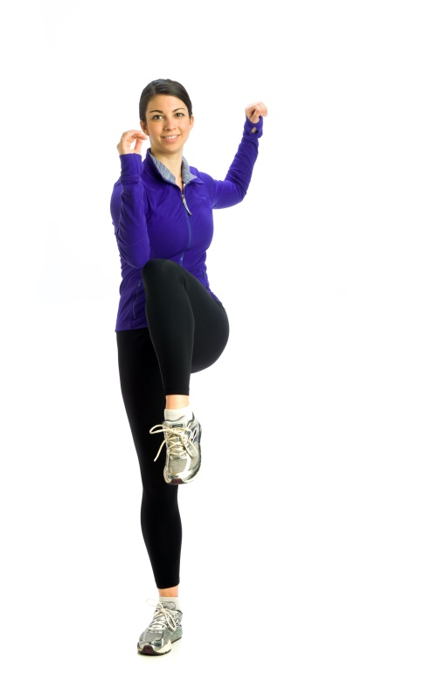
Physical Activities
Cardio with Warm-Up
Option A: Walk Indoors with Leslie Sansone DVD
Option B: Cardio Pyramid with Warm-Up
Notes:
All lessons (except for the first lesson where we talk about what to expect for physical activities in future lessons) include a Let’s be active segment that is 10-20 minutes long. Each segment includes cardio with a warm-up:
Educators get two choices for the cardio and warm-up: 1) the Walk Indoors with Leslie Sansone DVD developed by Rutgers; most of you are familiar with this DVD. These segments take at least 15 minutes to complete; 2) the Eating Smart • Being Active Cardio Pyramid with Warm-Up. Early lessons in the series include the Basic Cardio Pyramid. As lessons progress through the series, the educator shows participants how to increase the intensity of the moves, AND a new move is added in each lesson. The Cardio Pyramid with Warm-Up takes about 7 minutes.
Choose one of these options, and use it through an entire series with a group rather than jumping back and forth between the two. Switching back and forth would confuse participants because both options build on themselves from segment to segment.
If you as an educator have some physical limitations, you may want to always use the Walk Indoors DVD.

Slide 10
Physical Activities
Notes:
This is a shot of the cardio options in Lesson 5 : Grains. You can see that both options are offered (Walk Indoors with Leslie Sansone DVD and Cardio Pyramid with Warm-Up). However, when teaching this lesson, you will use the option you have used in previous lessons with that particular group.

Slide 11
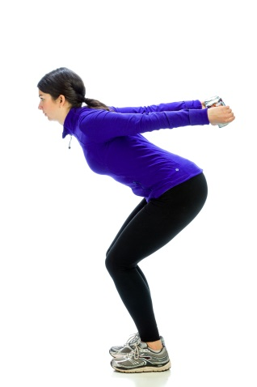
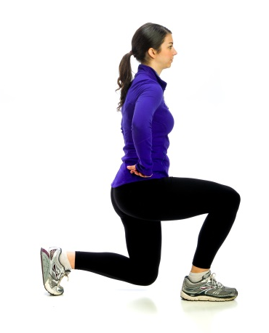
Physical Activities
Strength-building activity
Notes:
Strength-building activity
After the cardio activity (walking DVD or Cardio Pyramid), every lesson has a different strength-building activity that targets muscle- and/or bone-strengthening. Some of these activities include calf raises, lunges, and triceps kickbacks.
These strength-building activities take no more than 3-5 minutes to complete.

Slide 12
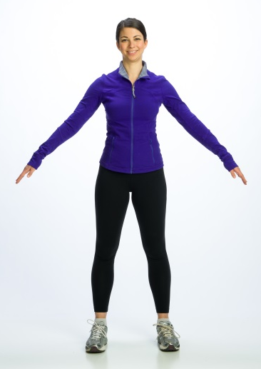
Physical Activities
Cool down
Notes:
Cool down – the final step to the physical activity in each lesson is a brief cool down.

Slide 13
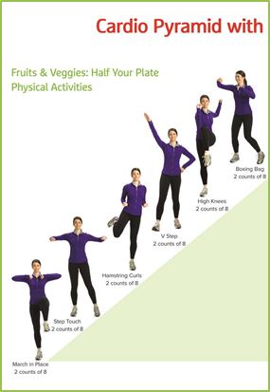
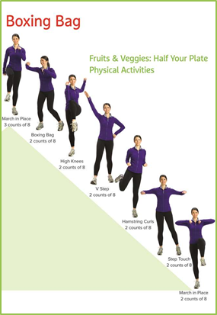
Physical Activity Visuals
Notes:
The Cardio Pyramid with Warm-Up cannot be led effectively if you are reading the lesson plan. For this reason, physical activity visuals for each lesson are included in addition to the 3 content visuals in each lesson. When leading the physical activities, follow these visuals to keep yourself on track.
Each lesson has its own cardio pyramid visuals. At first glance they may look similar, but they aren’t. After lesson 3, each cardio pyramid is a bit different, adding intensity in some of the lessons and each lesson has a new and different move at the top of the pyramid.

Slide 14
Physical Activity Visuals
Notes:
The lesson title is on each set of physical activity visuals to help you know you have the right visuals for that lesson.

Slide 15
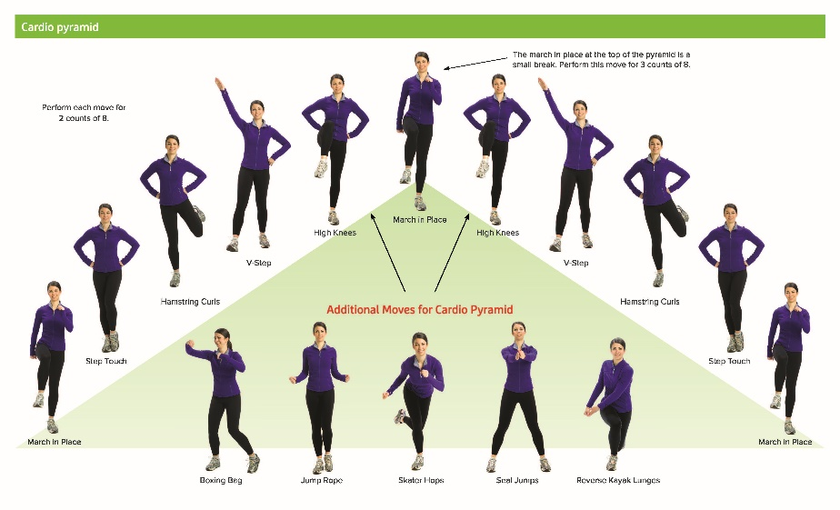
Physical Activity Handout
Notes:
In lesson 2, Get Moving, physical activity is introduced. In that lesson, participants also are given the physical activity handout that includes all of the cardio pyramid moves, the warm up, and the strength-training activities.

Slide 16
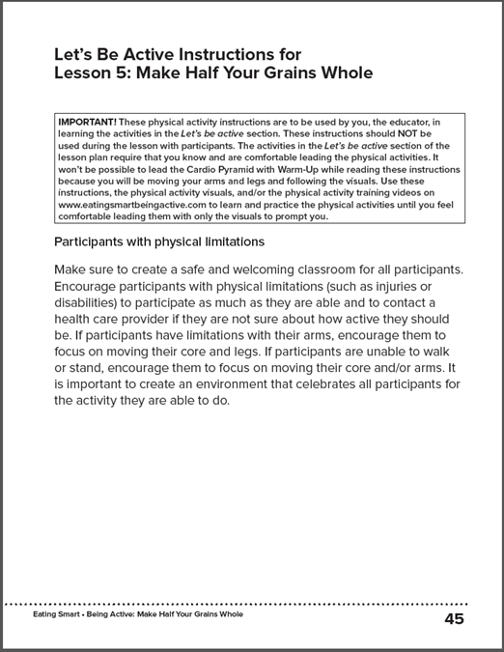
Learning the Physical Activities
Step-by-Step Instructions: detailed instructions for learning and practicing the physical activities
Notes:
While the Cardio Pyramid with Warm-Up and strength-training activities are pretty easy to follow, they take practice to be able to facilitate them in class. Therefore, a couple of useful tools were developed for you to use to learn the physical activities.
Step-by-step instructions for learning and practicing the Cardio Pyramid with Warm-Up and all strengthening activities are listed in the back of each lesson plan booklet. Practice the physical activities using these instructions when preparing for class. Learn and practice the activities until you feel comfortable leading the activities with just the visuals to guide you.

Slide 17
Learning the Physical Activities
Notes:
The picture on the left is the physical activity script in the Let’s be active segment of the lesson plan. The picture on the right is the Let’s be active instructions at the back of the lesson plan booklet.
The detailed instructions for the physical activity segments are after the lesson plan (before the FYI), not in the lesson plan itself. You need to memorize and practice leading these segments before doing them in class because you will not be able to lead the Cardio Pyramid or Warm-Up while looking at the lesson plans.
The instructions for the strength-building activities are in both places. That is because we want you to use the script associated with the exercise to lead the activity in class. This will help people perform the activities correctly and reduce the risk of injury.

Slide 18
Learning the Physical Activities
Physical Activity Training Videos
Series of training videos for educators
Available free at www.eatingsmartbeingactive.com > Resources for Implementation > Physical Activity > Physical Activity Training Videos
Notes:
A series of training videos was developed for the new physical activity segments. You can access the videos any time to practice. These are available for free on the Eating Smart • Being Active website. These videos were not designed to be used in class. It is important that you act as role models for your participants and lead them in the physical activities.

Slide 19
What to Wear
Important for you and your participants
Wear comfortable shoes and clothes
Tennis/athletic shoes
Clothes you can move in
Avoid
Tight, restrictive clothes
High heels or sandals
Remember:
Keep within dress code
Representing CSU
Notes:
Wearing safe and comfortable clothing for physical activity is important for both you and your participants. Talk with them at the first class about the physical activity segment and the best types of clothing for them to wear when they come to class.
Being physically active will require comfortable, moveable clothing. It will be important to wear shoes that allow you to be active without getting hurt. Tennis or athletic shoes are a great option and acceptable to wear. Choosing breathable clothing that you can easily move in is also important for when your body warms up with the intense movement of the added activity. There are some yoga/exercise pants that are made to look like a professional pair of pants. This may be a good option to stay comfortable and allow full movement during the physical activities. You may even want to consider wearing a sports bra depending on the physical activities you are doing that day.
You will want to avoid wearing tight pants or skirts that do not let you move freely. High heels and sandals may be dangerous and uncomfortable to wear with the added movement. You will also want to avoid wearing low-cut shirts or pants that may become inappropriate with movement.
It’s important to us that you are safe and comfortable during your classes, but please remember that you are representing your institution and need to keep all clothing choices appropriate. If you have any questions about what to wear, please don’t hesitate to ask.

Slide 20
Music for Physical Activity
Appropriately-paced music
Samples available at www.eatingsmartbeingactive.com > Resources for Implementation > Music
Playing music in class
Notes:
Appropriately paced music - When you choose Option B: Cardio Pyramid with Warm-Up for the Let’s be active segments, you will need appropriately-paced music. Music that is too fast will make it hard to follow the physical activity, and music that is too slow will make the segment boring for participants and not get their heart rates up. Samples of appropriately-paced music are on the Eating Smart • Being Active website.
Playing music in class – you have several options for playing music in class. We recommend one of the following methods so participants can hear the music:
Smartphone with Bluetooth speakers – some educators may like to use music they have on their phones. If so, we recommend a Bluetooth speaker to accompany the phone. Smartphone speakers alone will not produce sufficient volume to be heard by a group. Decent quality, light-weight Bluetooth speakers can be purchased through places like Best Buy or Amazon for between $10 and $20.
CD player – of course, you will need to purchase CDs if using a CD player.
Computer with speakers – some educators may choose to play music through a laptop. We also recommend using Bluetooth speakers if using a laptop because the speakers on the laptop are not sufficient for a group to hear well.

Slide 21
Use the Training Videos
www.eatingsmartbeingactive.com > Resources for Implementation > Physical Activity
Notes:
This was an introduction to the physical activity segments. The training videos mentioned earlier include in-depth training on all of the physical activities. Your homework is to watch these videos and practice doing the activities. Your supervisor will work with you to schedule opportunities for you to practice teaching co-workers. Remember, it is much easier to follow someone else leading the physical activities than it is to be the leader. Take time to practice LEADING them.

Slide 22
The Physical Activity Training Videos
Introductory Videos
Instructional Videos
Lesson Videos
Notes:
There are three kinds of physical activity training videos on the website:
Introductory Videos – two introductory videos provide an overview of physical activity, why and how physical activity are included in Eating Smart • Being Active, and tips and tricks for effectively teaching the physical activity segments in class.
Instructional Videos – every exercise included in the physical activity segments has its own instructional video. These videos are designed to help you learn each exercise individually so you can demonstrate and teach each exercise safely and effectively.
Lesson Videos – every lesson has its own lesson video about the Let’s be active segment in that lesson. These videos will help you learn how to put all of the exercises together and give you an opportunity to practice leading the physical activities.
Do the videos in this order: Introductory > Instructional > Lesson. The lesson videos will be what you will use to learn and practice the physical activity segments taught in each lesson.

